Slide 1
Cigarettes & E-Cigarettes Among College Aged Students: A Useful Application of Logistic Regression
Team Name: DigiDestined
Team Members: Corey Cooper & Safin Salih
MATh 4991 Presentation
Dr. Yi Jiang

Slide 2
Outline for presentation
Background information on e-cigarettes
Market sales of e-cigarettes over the years since their introduction
A glimpse at our survey
How the data was collected
A look at our logistic regression
Results
Open the floor to questions

Slide 3
Background Info On E-Cigarettes
E-cigarettes are devices that allow tobacco users to inhale nicotine through an aerosol, which is a system of particles that when a person smokes, all nicotine particles come out as smoke or gas.
Was first developed in modern times in China by Hon Lik, a pharmacist.
In 2004, e-cigarettes were introduced into the Chinese markets.
By the midd-2000s, more likely around 2006, e-cigarettes became apart of the US market

Slide 4
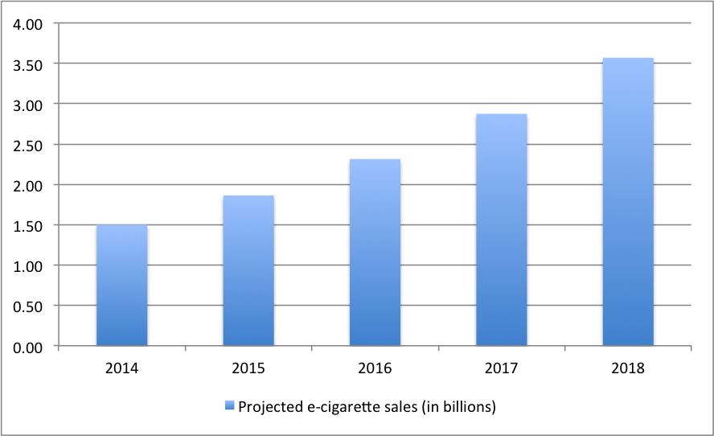
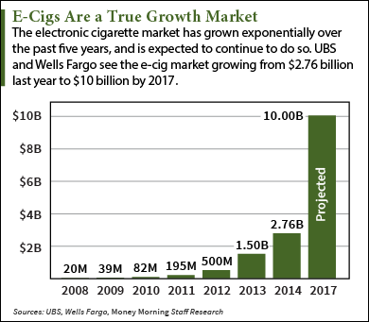
E-Cigarettes in the Market
Since 2007, sales of e-cigarettes have risen in the US
By 2013, e-cigarettes became worth $1 billion in the industry

Slide 5
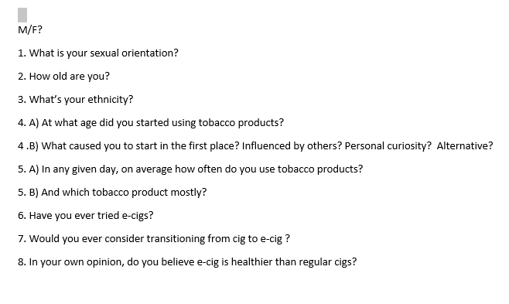
Glimpse At our Survey

Slide 6
Where our Data Came From
Smoking Area of Library Plaza
(Majority of data comes from here)
Front of Langdale Hall
In front of the library

Slide 7
Objective:
Population=GSU students that smoke tobacco
Sample size= 84 GSU students who currently smoke tobacco
Primary goal: To find one or many predictor variable(s) with high statistical significance that would help determine the outcome of transitioning from cig to e-cig. A best fit model that would best help determine the outcome of transitioning from cig to e-cig.
Method of gathering data by interview survey/questionnaire.

Slide 8
Biases
Most people like to present themselves in a favorable light, so they will be reluctant to admit to unsavory attitudes . Instead, their responses may be biased toward what they believe is socially desirable.
The wording of a question or how it’s being said can favor one response over the other.
Other bias can include location and timing in which the survey interview took place .
Etc etc

Slide 9
Questions we asked

Slide 10
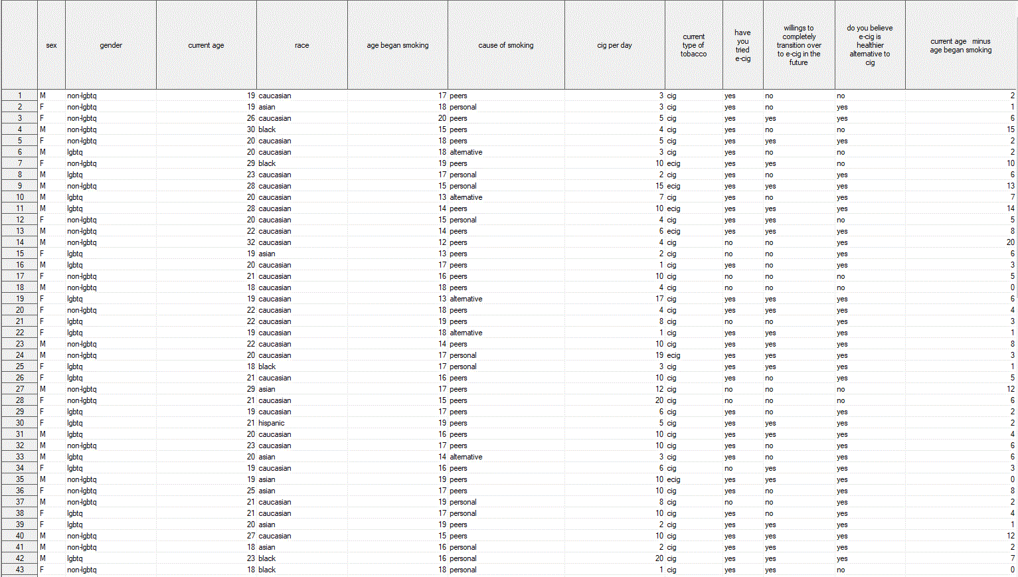
Data we collected

Slide 11
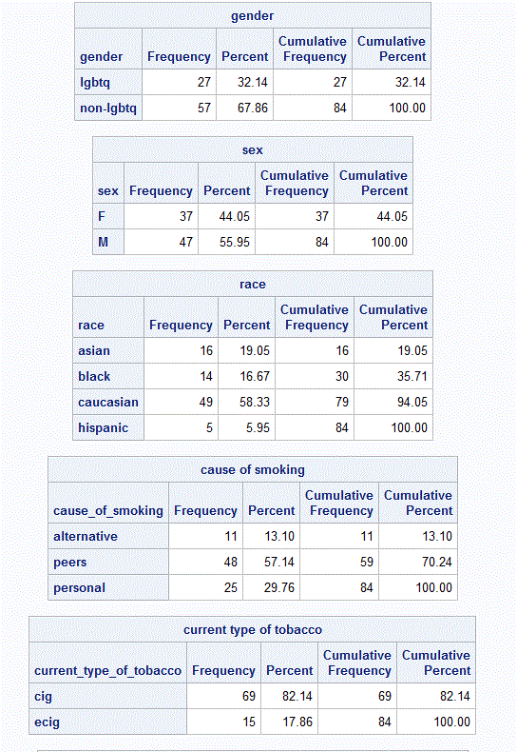
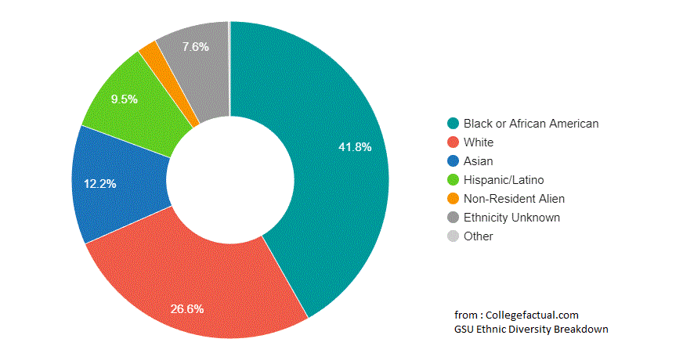
Frequency Table

Slide 12
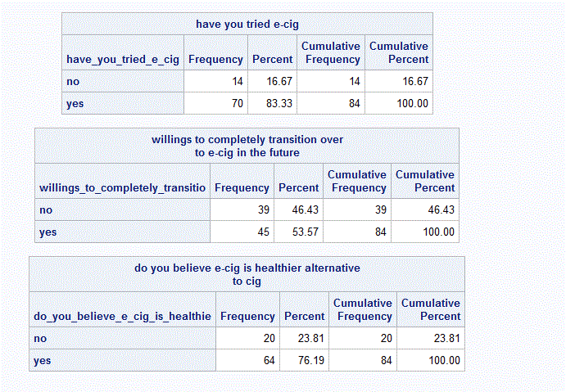

Slide 13
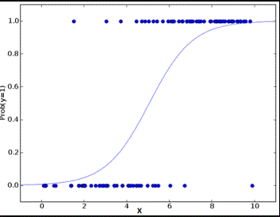

Since our independent variables can be continuous, or categorical and our response variable is dichotomous ( yes or no). We have to use logistic regression to help us analyze our data set and create a best fit model.
Logistic regression follows Pr(Y=1) = $\frac{1}{1+e^{−(B_{0}+B_{1}X_{1}….B_{k}X_{k})}}$
which looks like an “S” curve shape or sigmoid curve.

Slide 14

Transform from Logistic to Linear
Pr(Y=1) = $\frac{1}{1+e^{−(B_{0}+B_{1}X_{1}….B_{k}X_{k})}}$ (or Pr(Y=1) = $\frac{e^{\left(B_{0}+B_{1}X_{1}….B_{k}X_{k}\right)}}{1+e^{(B_{0}+B_{1}X_{1}….B_{k}X_{k})}}$)
And the regression coefficients $B_{k}$ tells us important information about the relationship between the predictor to the dichotomous depend variable. These coefficients are often used to estimate a parameter called odds ratio.
Logit(Pr(Y=1)=l$og_{e}\left(odds\left(Y=1\right)\right)=$
$$\log_{e}{(\frac{pr\left(y=1\right)}{1−pr\left(y=1\right)})}=B_{0}+B_{1}X_{1}….B_{k}X_{k}$$
Also called the logit form.

Slide 15

Example
Pr(y= cardiac arrest)=$\log_{e}{[\frac{pr\left(y=cardiac arrest\right)}{1−pr(y=cardiac arrest)}}]= b_{0}+b_{1}(age)$ .
Say for example the estimated coefficient $b_{1}$ for age is 0.01 . So one unit change in age, will result in 0.01 unit change in the log of the odds of getting cardiac arrest.

Slide 16
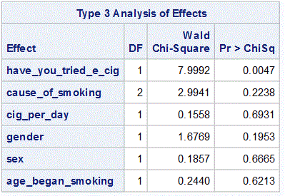
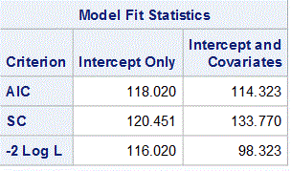
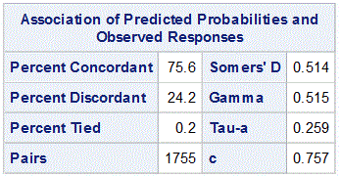
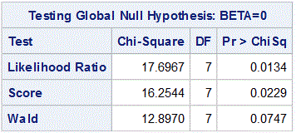
Model found that fits best

Slide 17
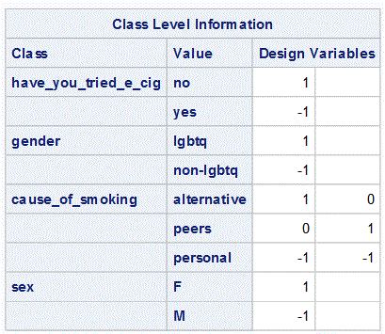
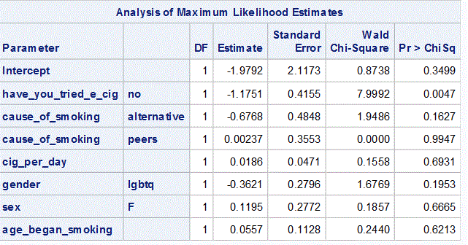

$$\log_{e}{[odds(y=\text{'}\text{yes}\text{')]= -1.9}792−1.1751x_{1}−.6768x_{2}+.0023x_{3}+.0186x_{4}−.3621x_{5}+.1195x_{6}+.0557x_{7}}$$
OR
$$pr\left(y=^{′}{yes}^{′}\right)=\frac{1}{1+e^{− (\text{-1}\text{.}9792−1.1751x_{1}−.6768x_{2}+.0023x_{3}+.0186x_{4}−.3621x_{5}+.1195x_{6}+.0557x_{7})}}$$

Slide 18
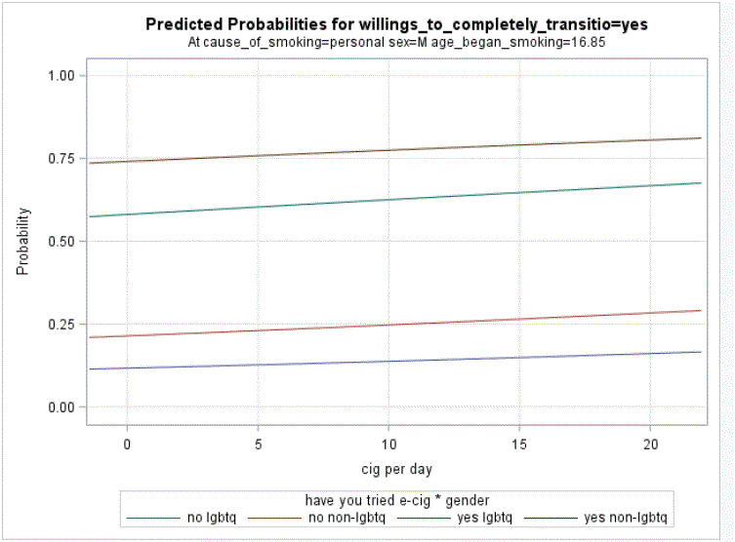

Slide 19
What We learned from our model
Saying “yes” or “no” to the question have you tried e-cig is the best predictor of transitioning to e-cig or not transitioning to e-cig.

Slide 20
Questions?

